Slide 1
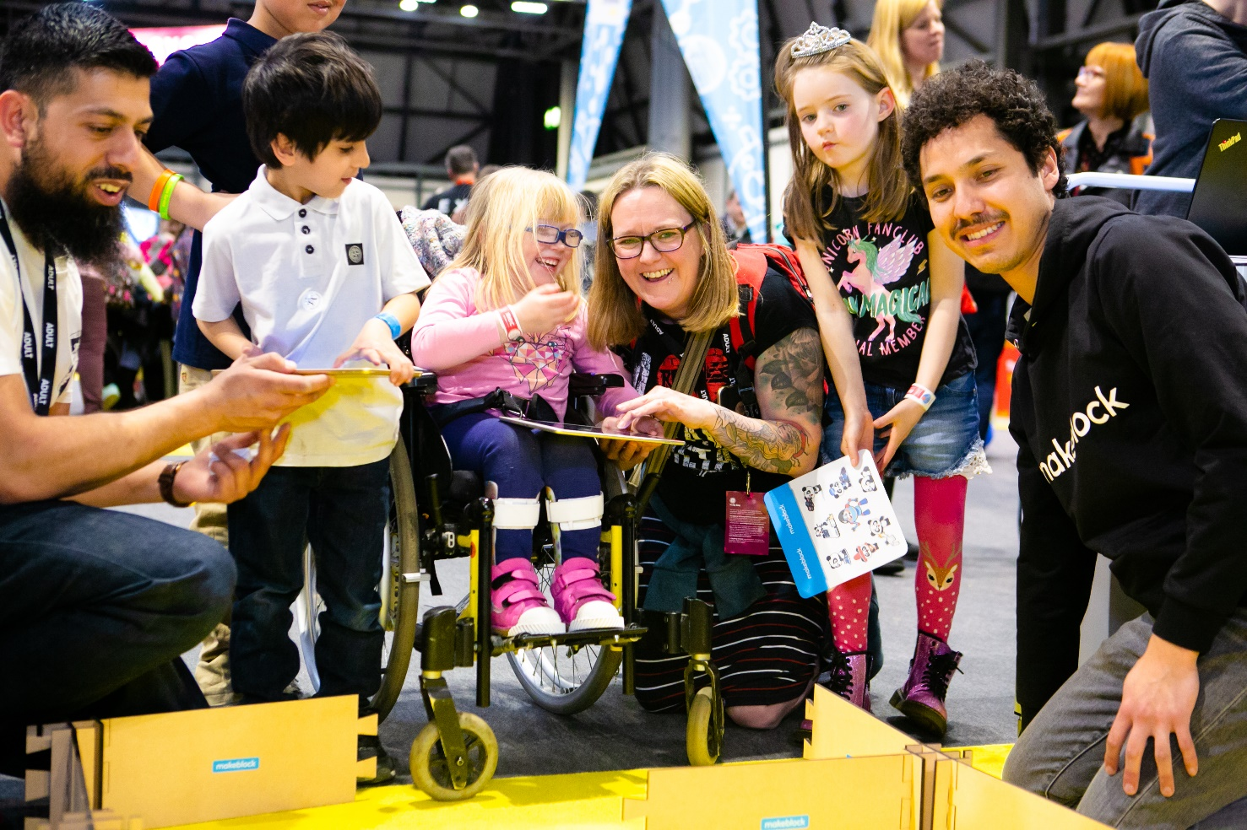
My visit to The Big Bang Fair

Slide 2
We want you to have a great visit to The Fair
This guide covers:
your arrival
where the toilets are
where to take a break
what The Fair environment is like
what activities you can experience
who you might meet
what to do if you become lost

Slide 3
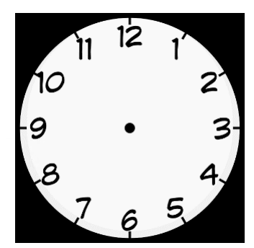
About me
My name is ………………………………………………
I will be visiting The Big Bang Fair on ……………………………
I will be setting off at:

Slide 4
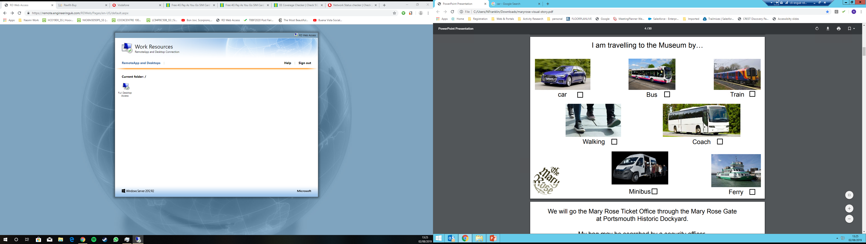
I am travelling to The Fair by…
Car
Bus
Train
Mini-bus
Coach

Slide 5
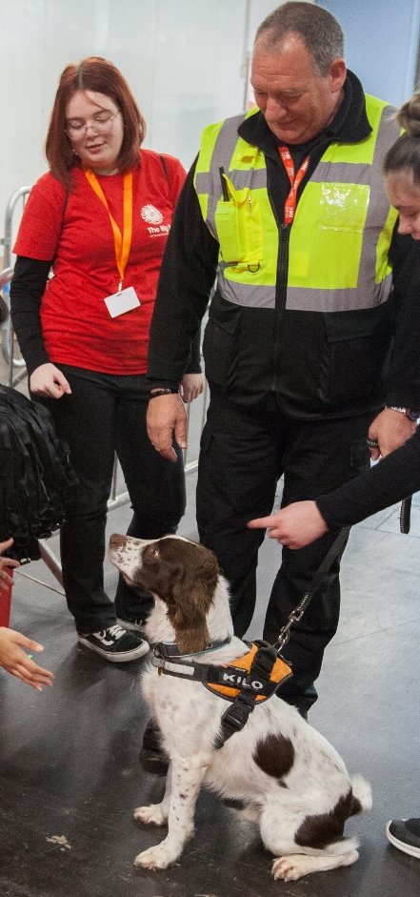
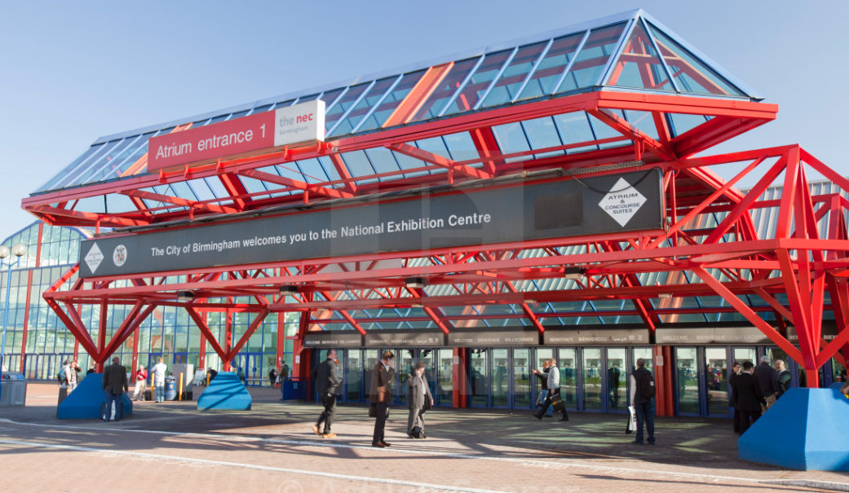
We will arrive at the NEC
I will go through this entrance to enter the Fair.
My bag may be searched and there may be security staff and dogs checking visitors

Slide 6
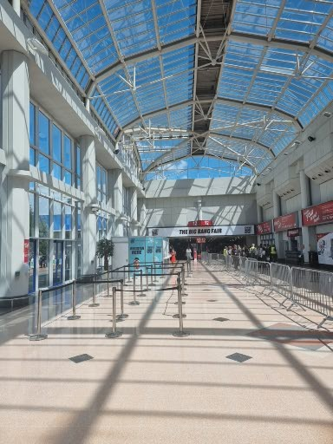
We will go into the Fair
I will go with my group to the registration queue.
It will be very busy.
My teacher will need to speak to the registration staff to get our badges and visitor information.
It may take 10 minutes to complete registration.

Slide 7
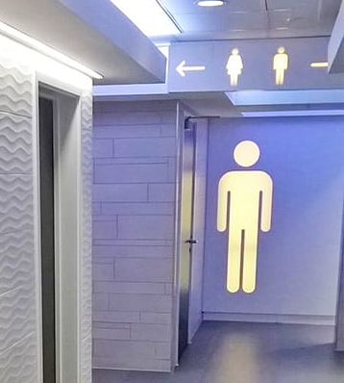
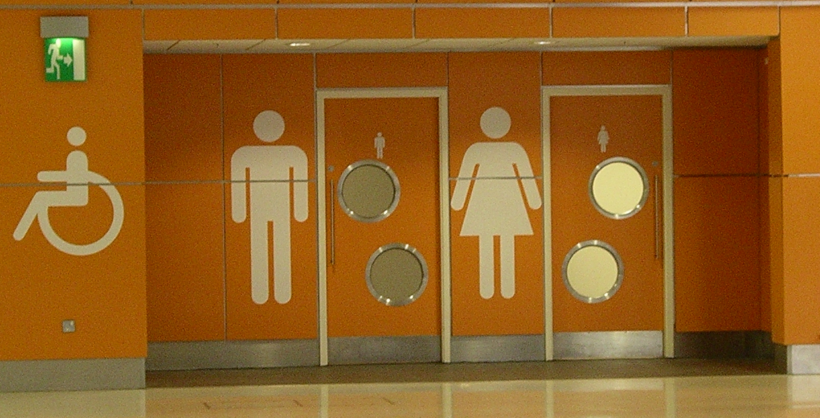
If I need the toilet…
The toilets near registration look like this:
The toilets inside the Fair look like this:

Slide 8
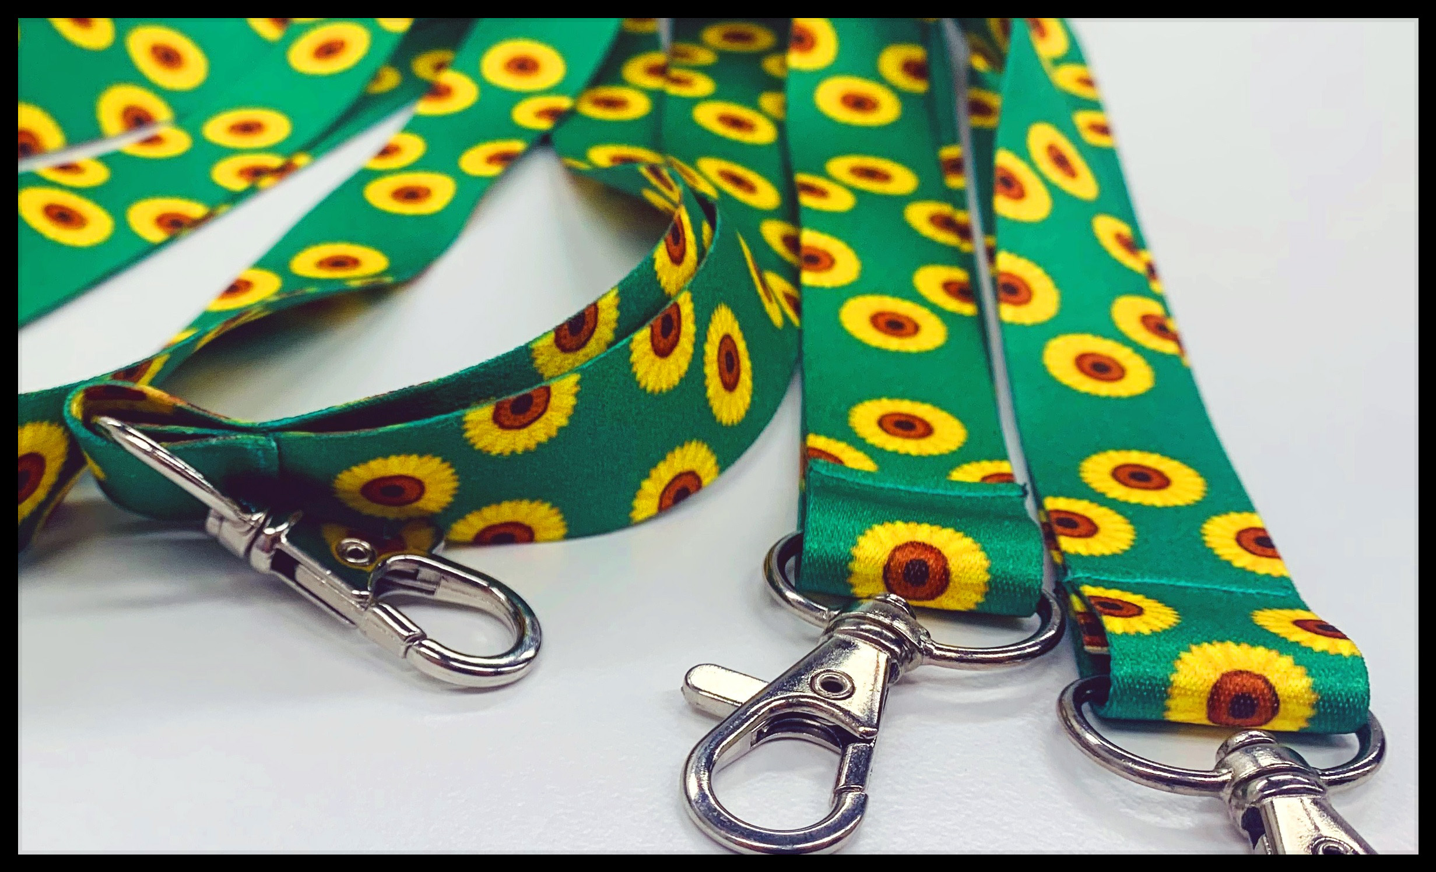
If I need a break…
I can go to the calm area or one of the quiet rooms.
My teacher will take me.
I will need a sunflower lanyard to get in.

Slide 9
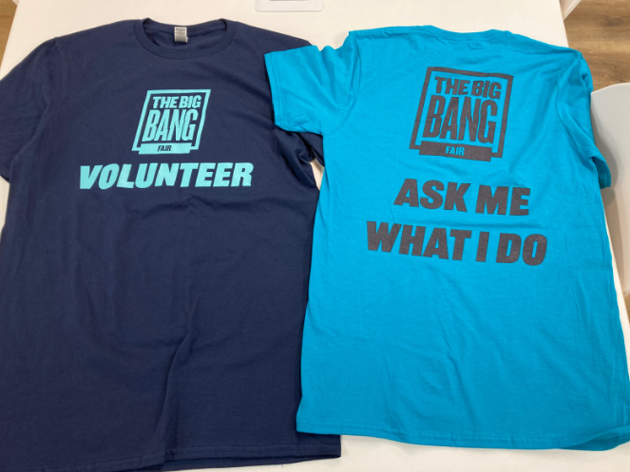
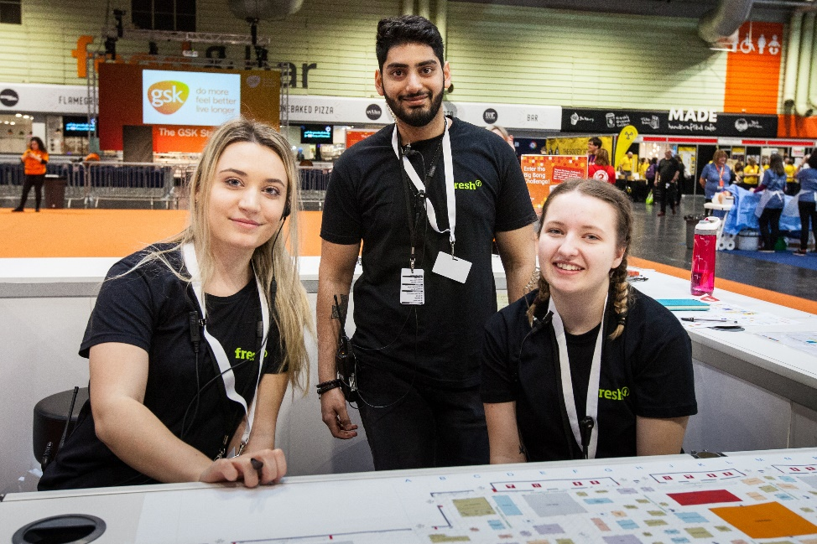
If I need help I can talk to an adult who works at The Fair
I can spot an adult as they will be wearing navy, blue or black t-shirts.
They might be walking around the exhibition or behind the information desks.

Slide 10
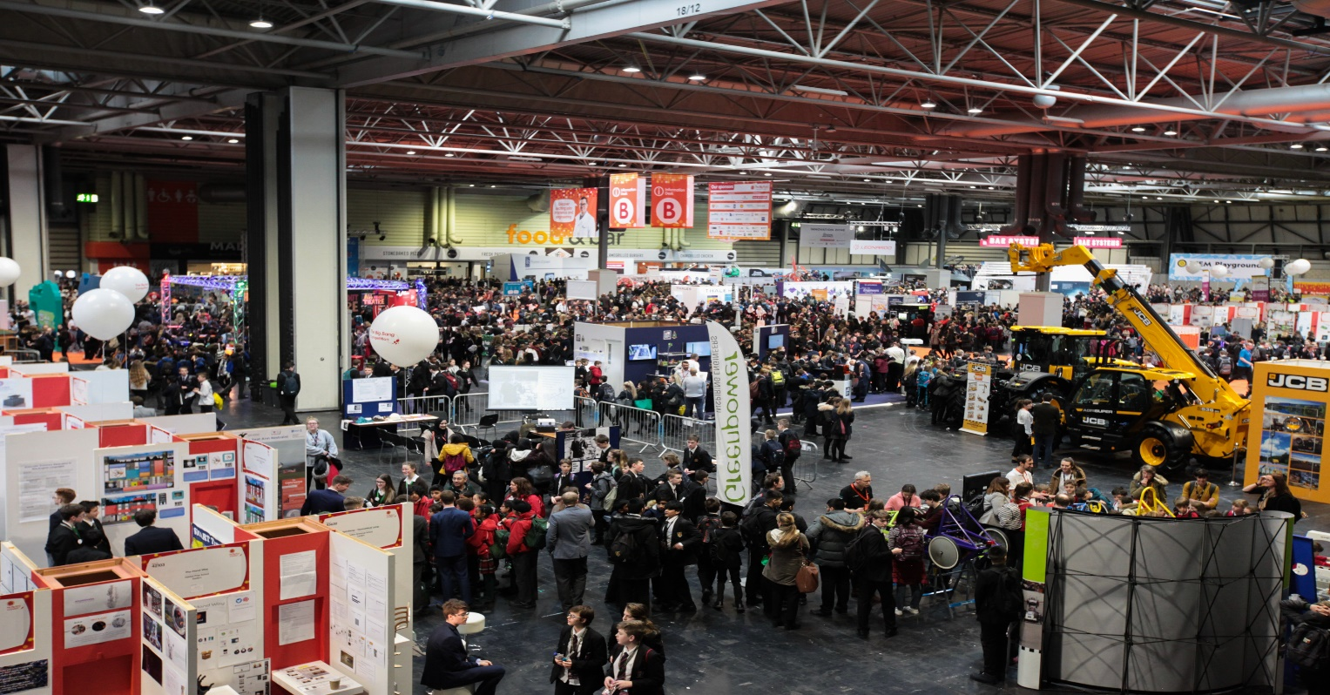
This is what it looks like inside the Fair
It may be very busy.
There will be lots of activities I can try.

Slide 11
At The Fair I will hear…
Lots of people talking
There may be some loud bangs
There may be equipment at exhibits that make noises
There may be announcements made to all visitors
In an emergency, I will hear the fire alarm
If it is too loud, I can ask my teacher to take me to the calm area or quiet room.

Slide 12
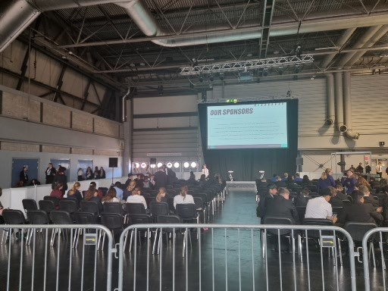
If I watch a panel talk…
I will join a queue.
I will be shown where to sit.
I will hear scientists and engineers talk about their jobs.
Some people in the audience will ask questions.

Slide 13
At the Fair I can try lots of hands-on activities
If I try an activity…
I may need to wait for my turn
There will be someone to tell me what to do
I might be asked questions about the activity and how it works
I don’t have to answer questions if I don’t want to
I can ask questions about the activity
There may be someone telling me about their job
If I want to stop an activity I can

Slide 14
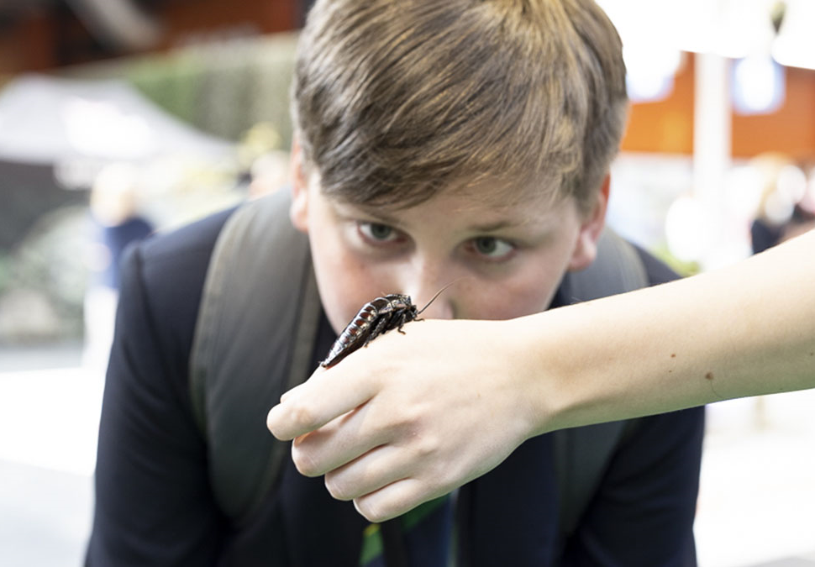
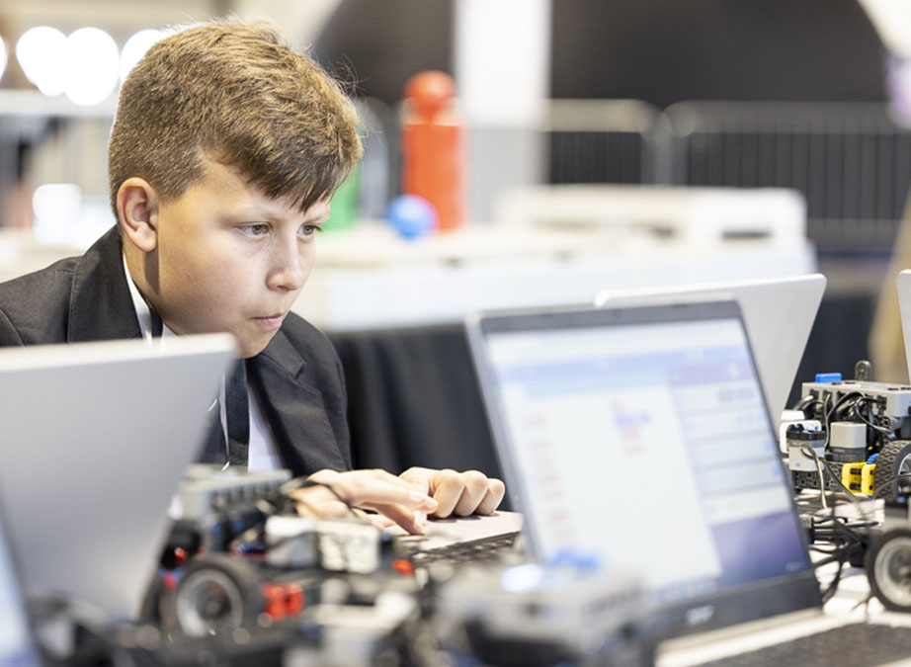
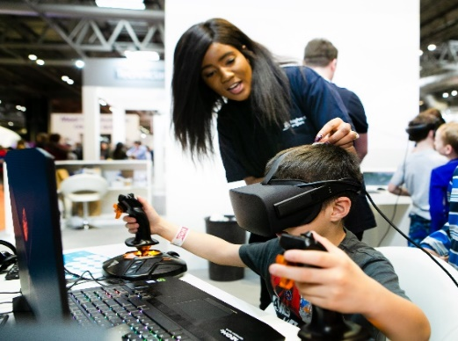
I can choose which hands-on activities to try
Here are some examples of what I might try….
discover insects
drone coding
virtual reality

Slide 15
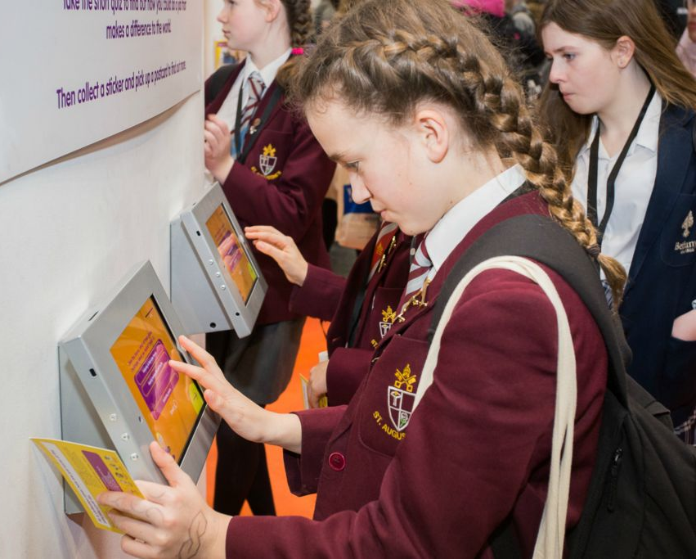
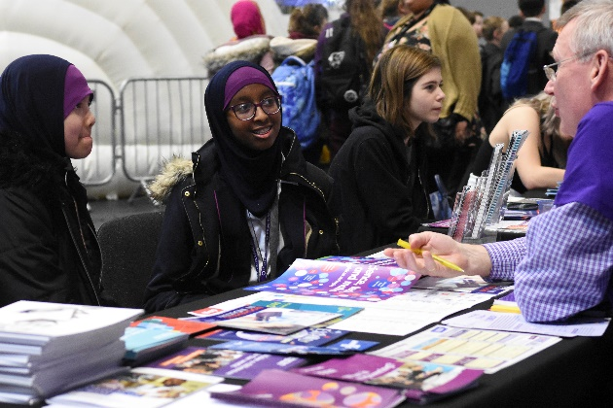
If I want to find out about jobs using science, engineering and technology I can…
Talk to people who use science,
technology and engineering in
their jobs. They are wearing blue t-shirts
Take the 'Meet The
Future You' quiz on an
iPad to learn what jobs are best for me

Slide 16
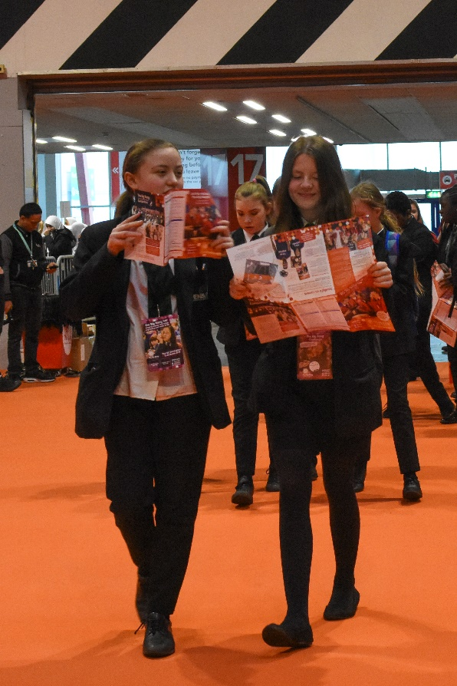
I can take part in Big Bang Explore
I will be given a Big Bang Explore form when I arrive
I can take part and enter a competition to win a prize
To take part I will need to talk to or hear from adults who use science, engineering and technology in their jobs and try different activities
To enter Big Bang Explore I will need to complete the form and hand it in at an information desk or entry box at the exit

Slide 17
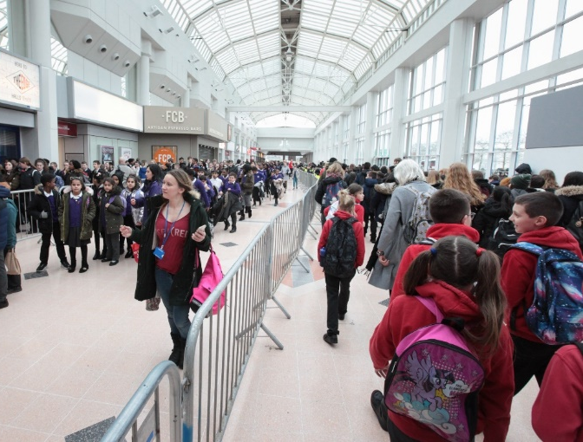
When I leave
Before leaving, an adult might ask me if I enjoyed The Fair. I can take part in the survey if I want to
When I leave, I will need to be sure I have everything I brought with me
I will go back through the entrance hall
I will need to follow the instructions of my teacher

Slide 18
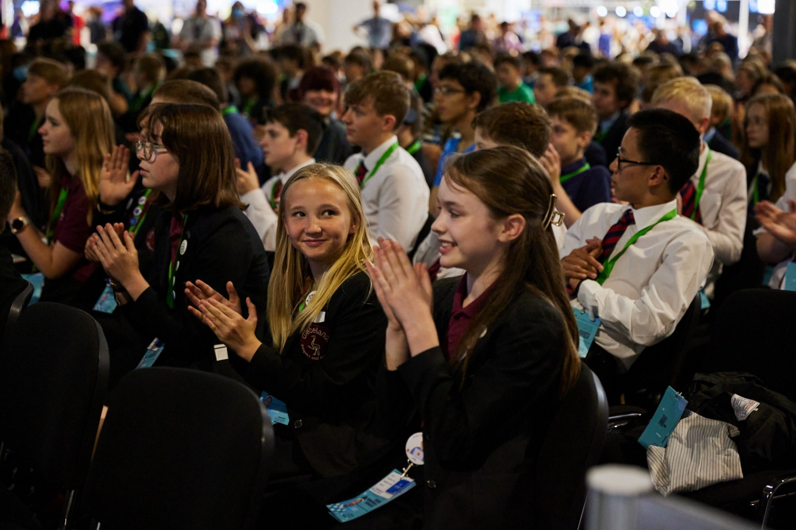
We hope you have a great visit to
The Big Bang Fair!

